Slide 1

Test of knowledge
By - Anurag V Kulkarni & Abhinav Tripathy

Slide 2
CONTENTS
01
02
03
04
INTRODUCTION
WORKING
PROJECT
OUTCOME

Slide 3
01
INTRODUCTION

Slide 4
INTRODUCTION
About our project,
This project uses Figma,Python and Tkinter.
Test of Knowledge(Quiz Game) is a collection of number of different types of quizzes like technical, games, sports, etc. There will be limited number of questions and for each correct answer user will get a credit score. To develop a user friendly quiz application which will contain : Numbers of quiz , MCQ style Answers, Feedback after every round of Quiz session.This helps to improve the knowledge level of users

Slide 5
02
WORKING

Slide 6
WORKING
Figma is a powerful design tool used to create : websites, applications, logos, etc.
Python is an interpreted, object-oriented, high-level programming language with dynamic semantics. Its high-level built in data structures, combined with dynamic typing and dynamic binding, make it very attractive for Rapid Application Development.
Tkinter is the standard GUI library for Python. Python when combined with Tkinter provides a fast and easy way to create GUI applications.

Slide 7
03
PROJECT

Slide 8
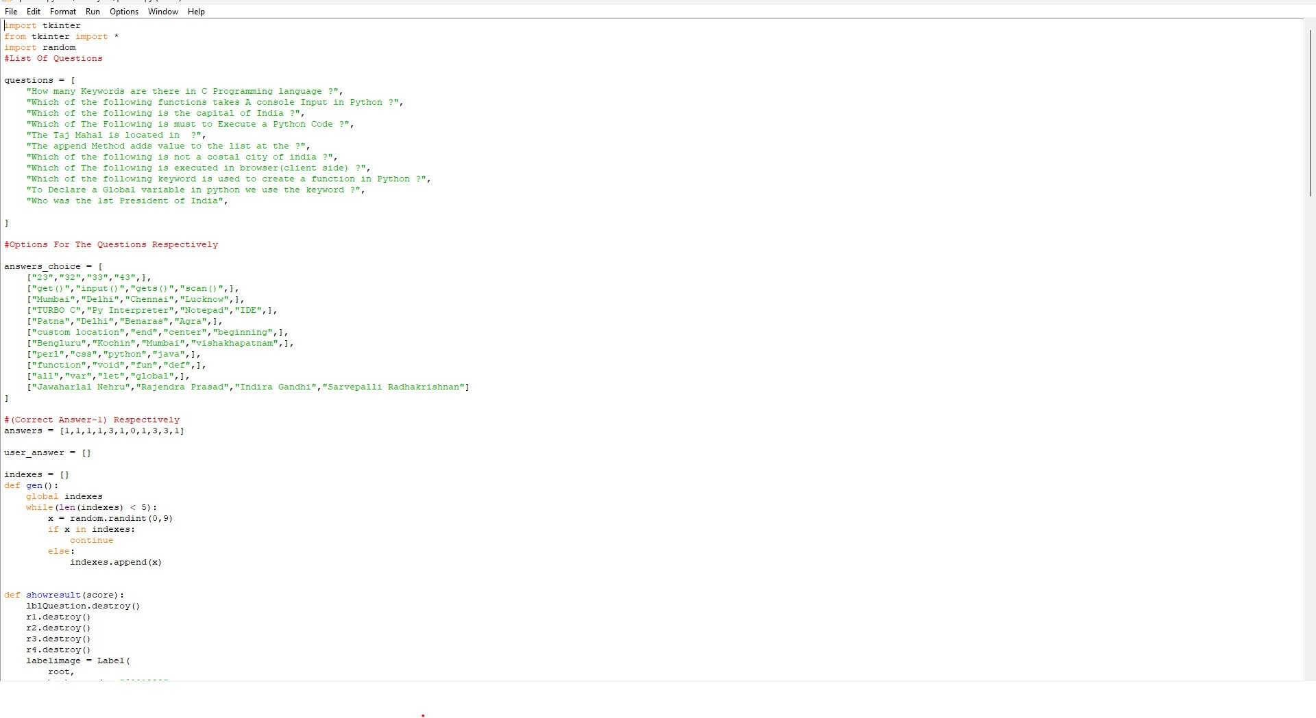

Slide 9
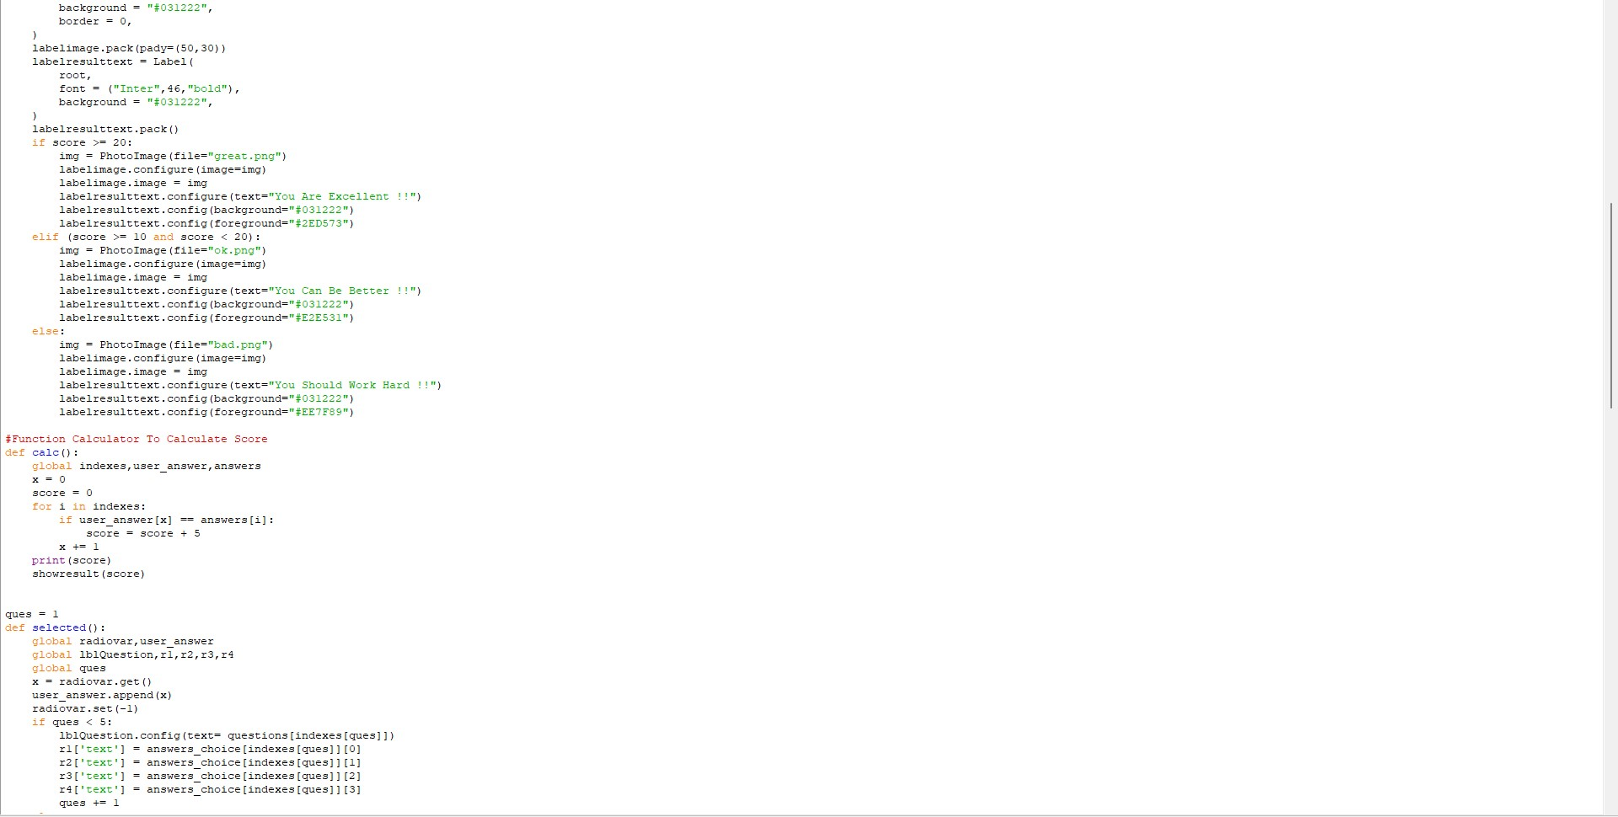

Slide 10
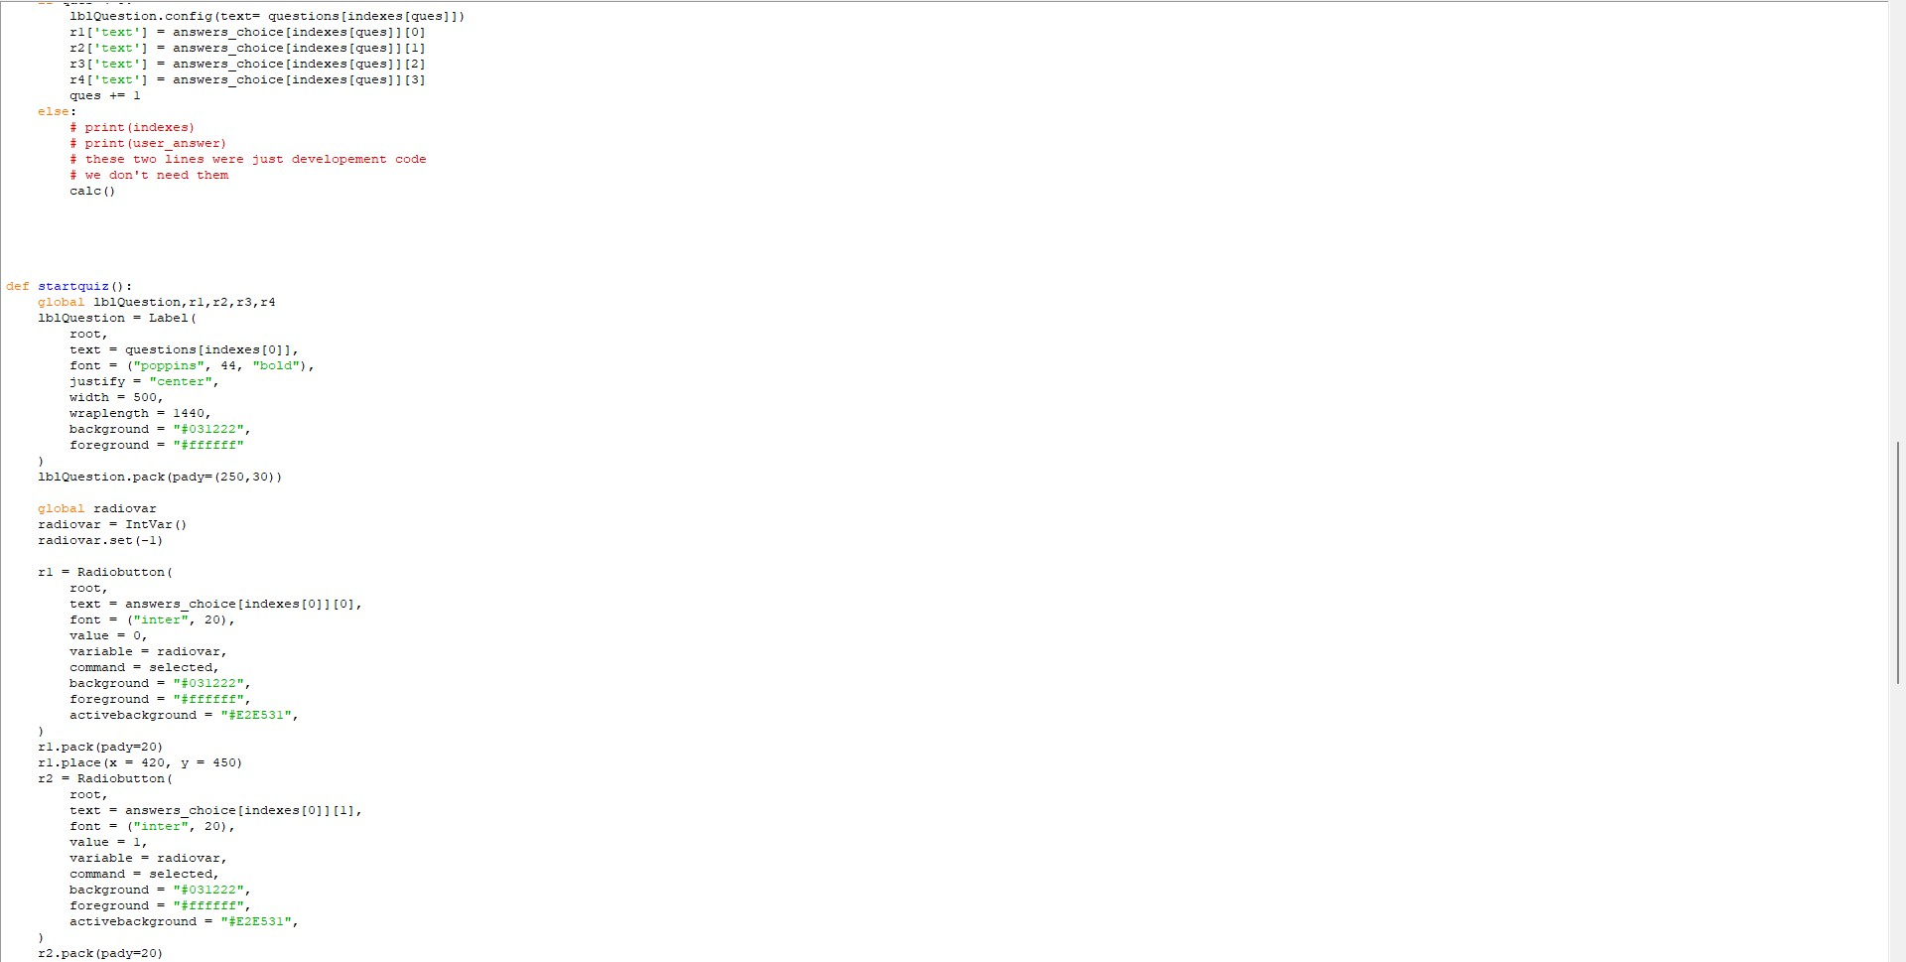

Slide 11
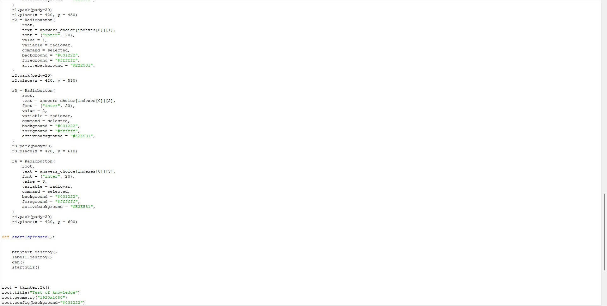

Slide 12
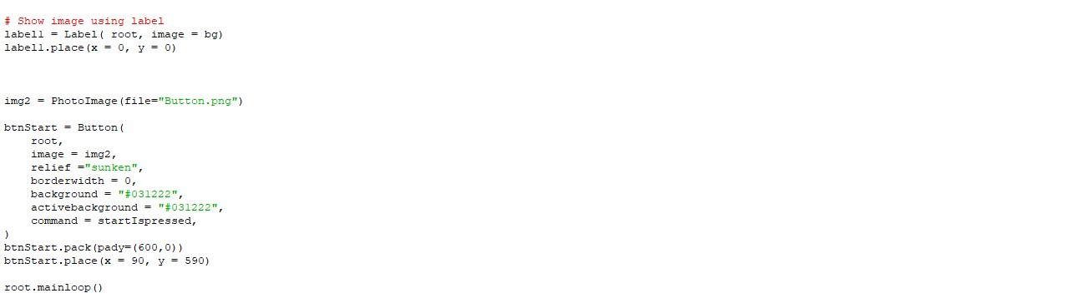

Slide 13
04
OUTCOME

Slide 14


Slide 15
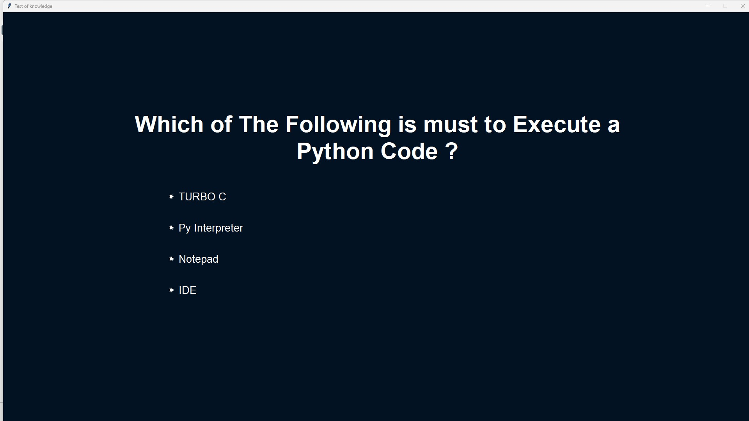

Slide 16
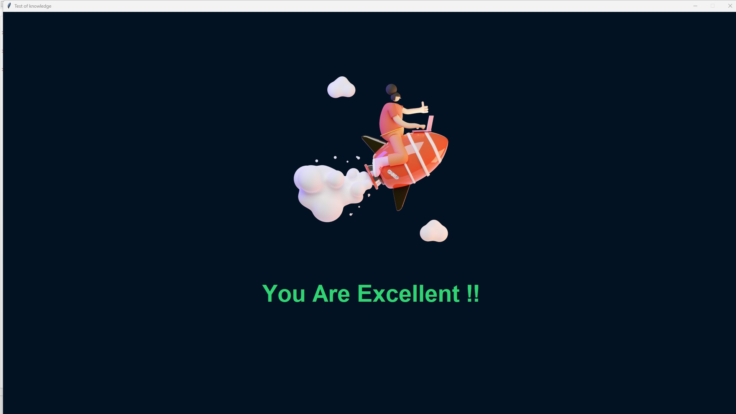

Slide 17
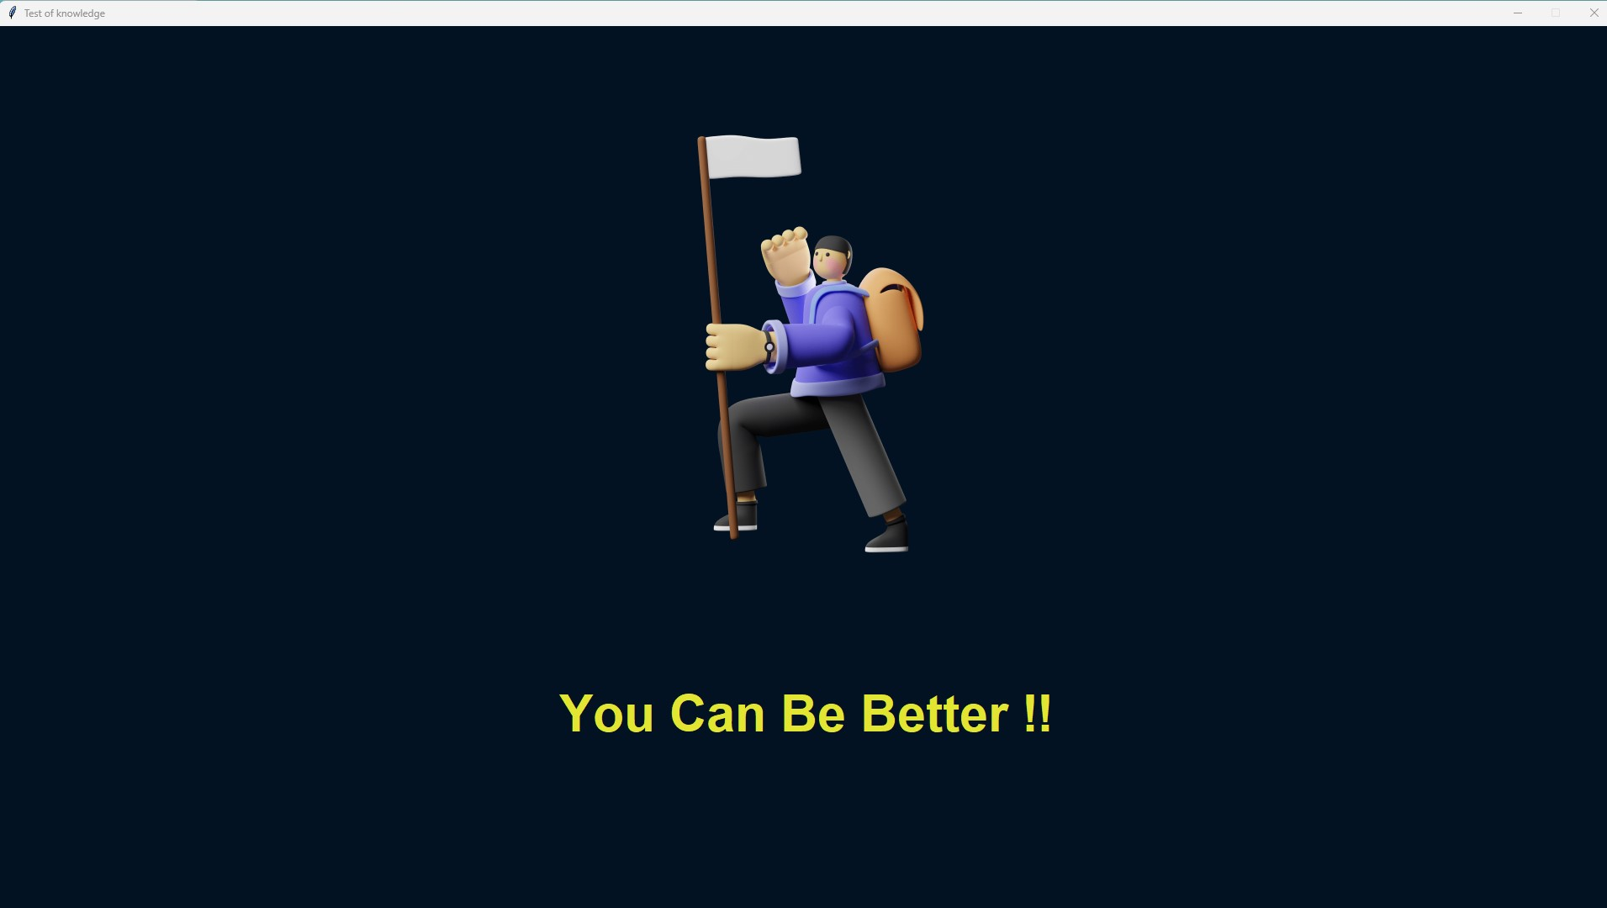

Slide 18
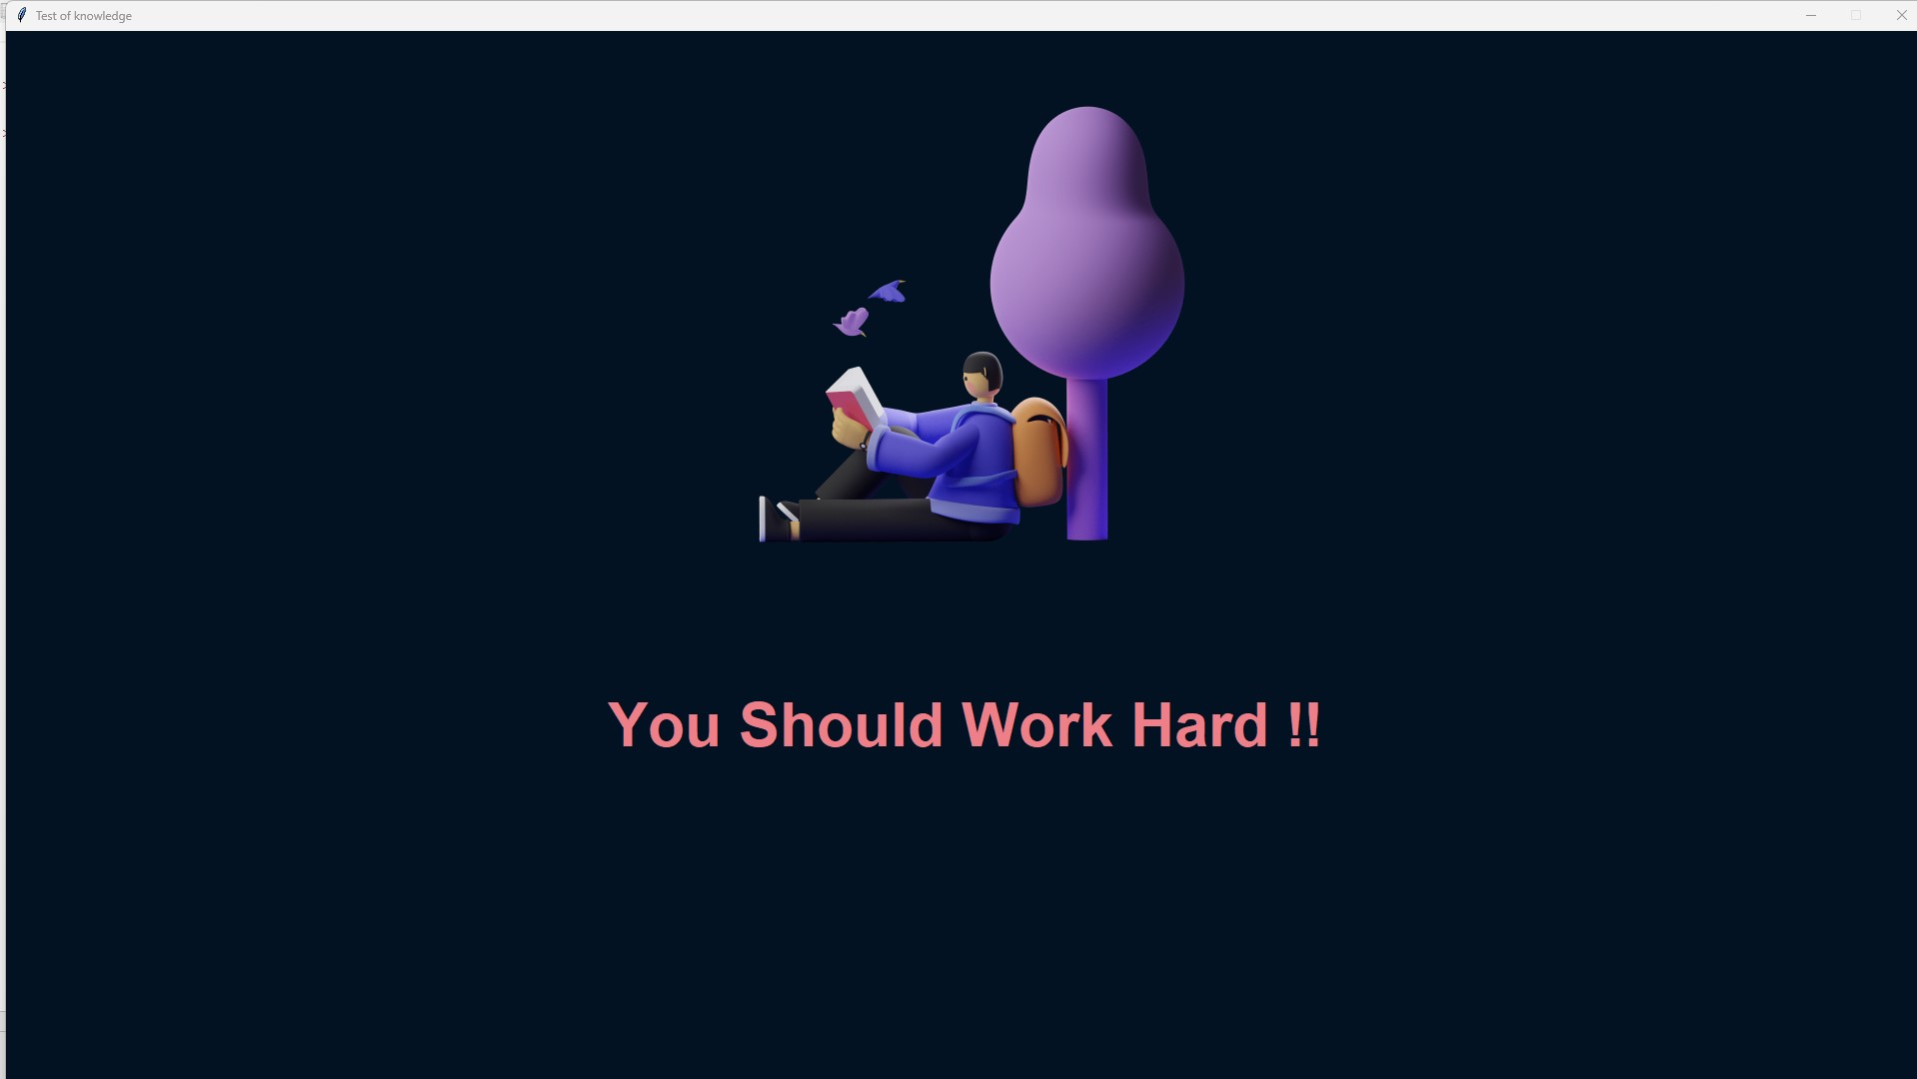

Slide 19
THANKS

